Slide 1

Wednesday Special: Data Exploration
Data Science Lifecycle
(Week 8 : Data Exploration of Financial Data-Amazon Stock data)

Slide 2
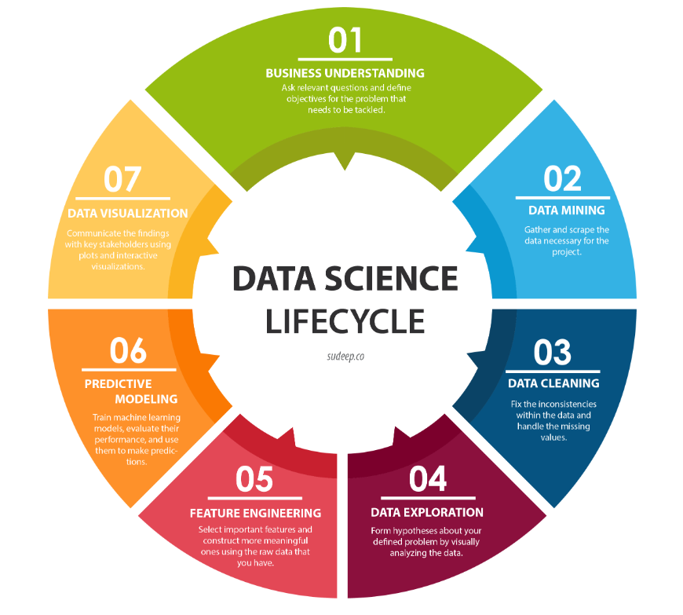
4. Data Exploration ­◉ Fourth step of the Data Science life cycle is Data Exploration

Slide 3
What is Exploratory Data Analysis?
In statistics, exploratory data analysis (EDA) is an approach to analyzing data sets to summarize their main characteristics, often with visual methods. A statistical model can be used or not, but primarily EDA is for seeing what the data can tell us beyond the formal modeling or hypothesis testing task

Slide 4
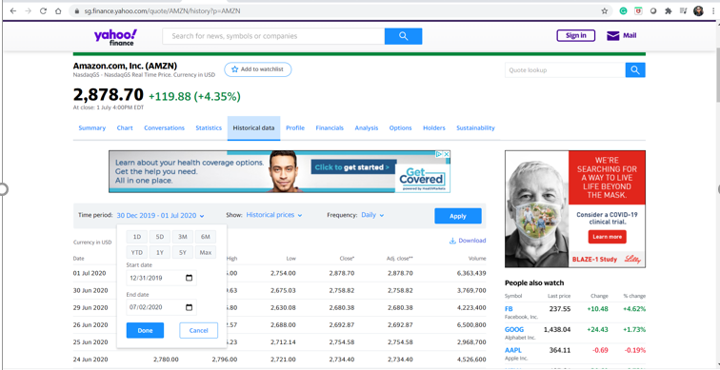
Data Exploration
Exploring the Amazon Stock data set for the time period between 12/31/2019 and 07/02/2020
Specifically chose this time period to analyze the impact of COVID19 on Amazon shares

Slide 5
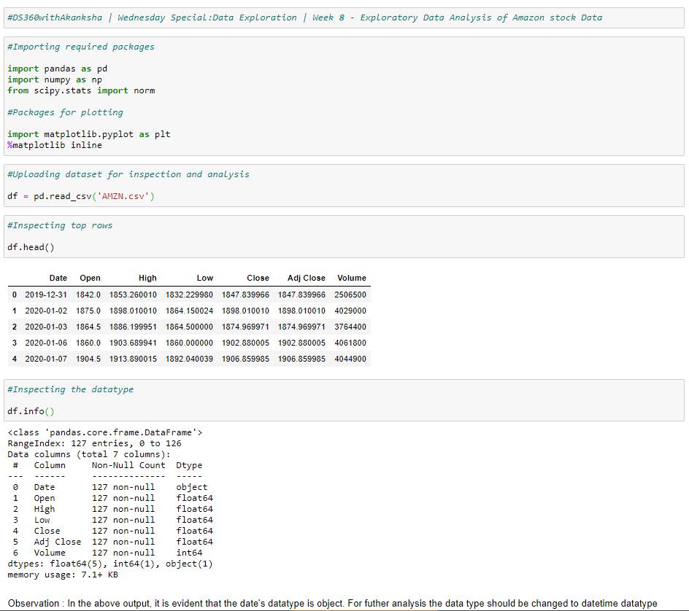
Data Exploration
Started the Data Exploration by importing required packages
Uploaded dataset for inspection and analysis
Inspected the top rows of the dataset and checked the datatype
Noticed that the date datatype is object instead of datetime

Slide 6
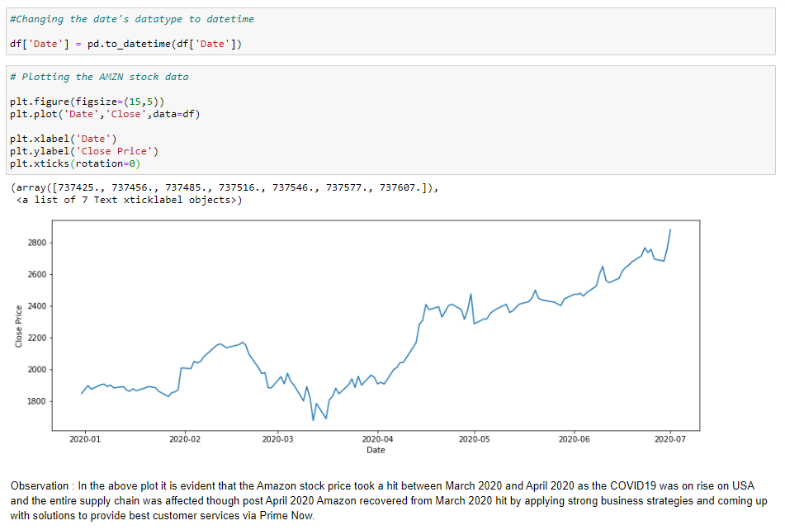
Data Exploration
Changed the datatype for date column to DateTime
Plotted the Amazon stock data from Jan’20 to Jul’20
Noticed that between Mar’20 & Apr’20 Amazon stock price took a hit, though it’s been increasing after Apr’20

Slide 7
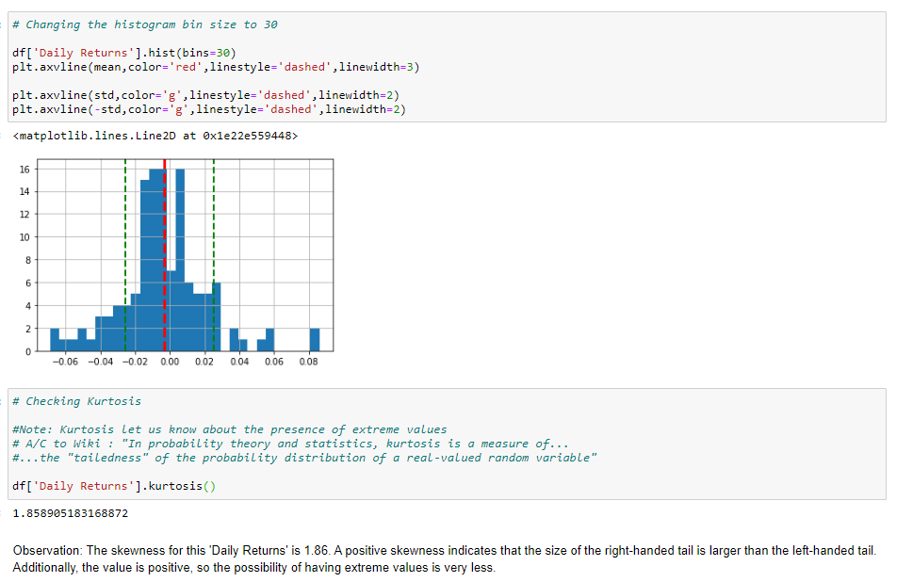
Data Exploration
Created new columns ‘Daily Lag’ & ‘Daily Return’ to analyze the returns on a daily basis
Plotted the histogram
Analyzed the Kurtosis, and noticed that there is a positive skewness which means there is very less chance of having extreme value

Slide 8
Next Step : 5. Feature Engineering

Slide 9
References
http://sudeep.co/data-science/Understanding-the-Data-Science-Lifecycle/
https://sg.finance.yahoo.com/
https://sg.finance.yahoo.com/quote/AMZN/history?p=AMZN
https://towardsdatascience.com/financial-analytics-exploratory-data-analysis-of-stock-data-d98cbadf98b9
https://www.kaggle.com/ranjitmishra/exploratory-data-analysis-of-stock-prices
https://www.linkedin.com/pulse/exploratory-analysis-financial-data-daniel-karp/
https://blog.exploratory.io/quantitative-financial-analysis-for-beginners-with-exploratory-io-and-tidyquant-808fe2793c2e
https://link.springer.com/chapter/10.1007/978-3-540-33037-0_32
https://cran.r-project.org/web/packages/PerformanceAnalytics/vignettes/PerformanceAnalyticsPresentation-UseR-2007.pdf
https://subscription.packtpub.com/book/data/9781789618518/8/ch08lvl1sec47/exploratory-data-analysis
http://citeseerx.ist.psu.edu/viewdoc/download?doi=10.1.1.514.6087&rep=rep1&type=pdf
https://www.kdnuggets.com/2018/09/financial-data-analysis-loan-eligibility-prediction.html
https://medium.com/developer-circles-lusaka/exploratory-data-analysis-a-case-study-512c47c1b162
https://www.statisticshowto.com/choose-bin-sizes-statistics/
https://en.wikipedia.org/wiki/Kurtosis
https://www.spcforexcel.com/knowledge/basic-statistics/are-skewness-and-kurtosis-useful-statistics

